Slide 1

Drawing Perfect Straight Line with TensorFlow

Slide 2
Reference
Youtube on Linear Regression
Youtube
Code

Slide 3
Warm Up

Slide 4
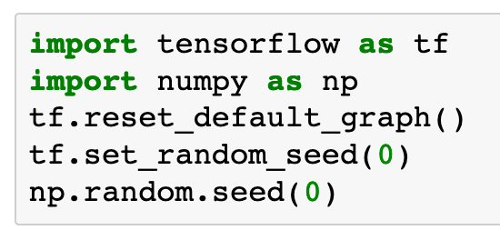

Slide 5
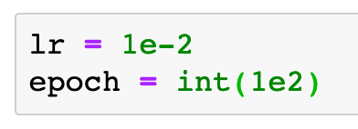

Slide 6
Data

Slide 7

Previously
Now

Slide 8
Previously
Now

Slide 9
Graph

Slide 10
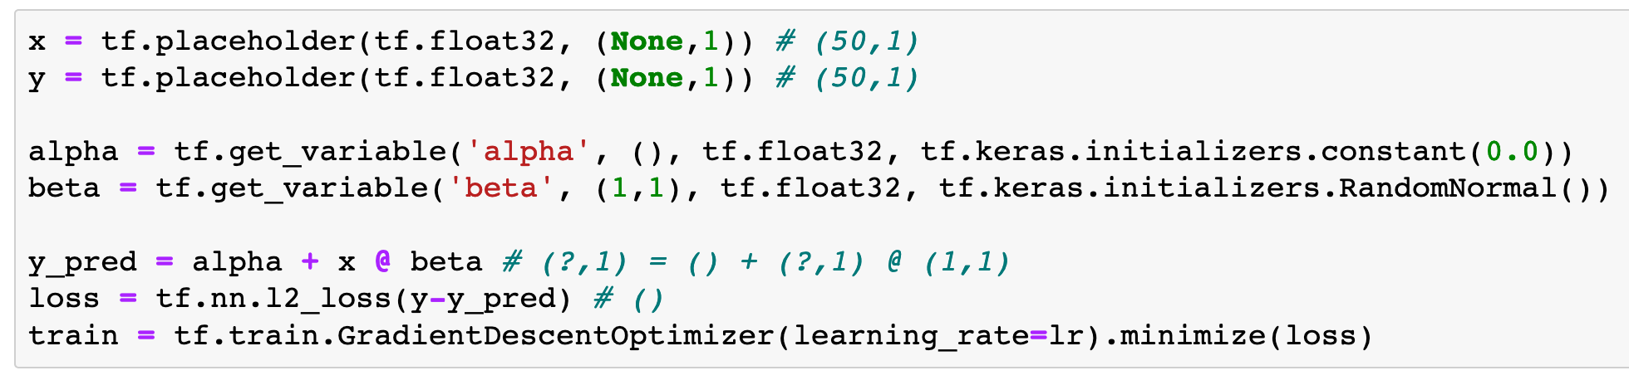

Slide 11
Session

Slide 12
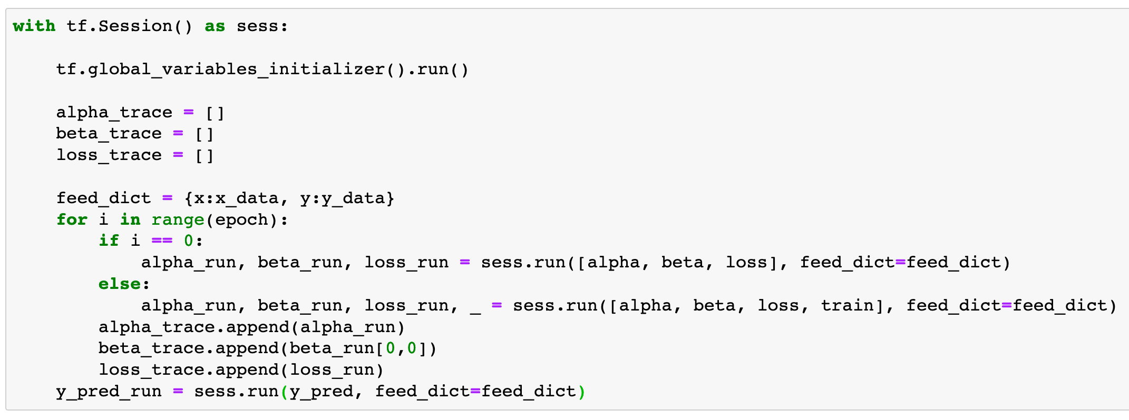

Slide 13
Report Result

Slide 14
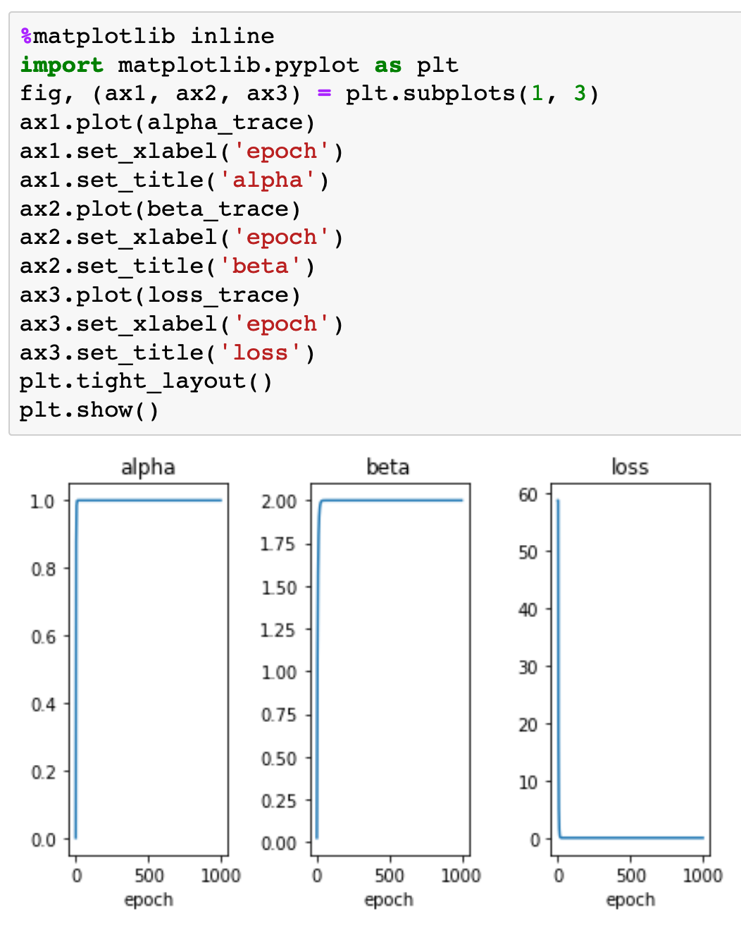
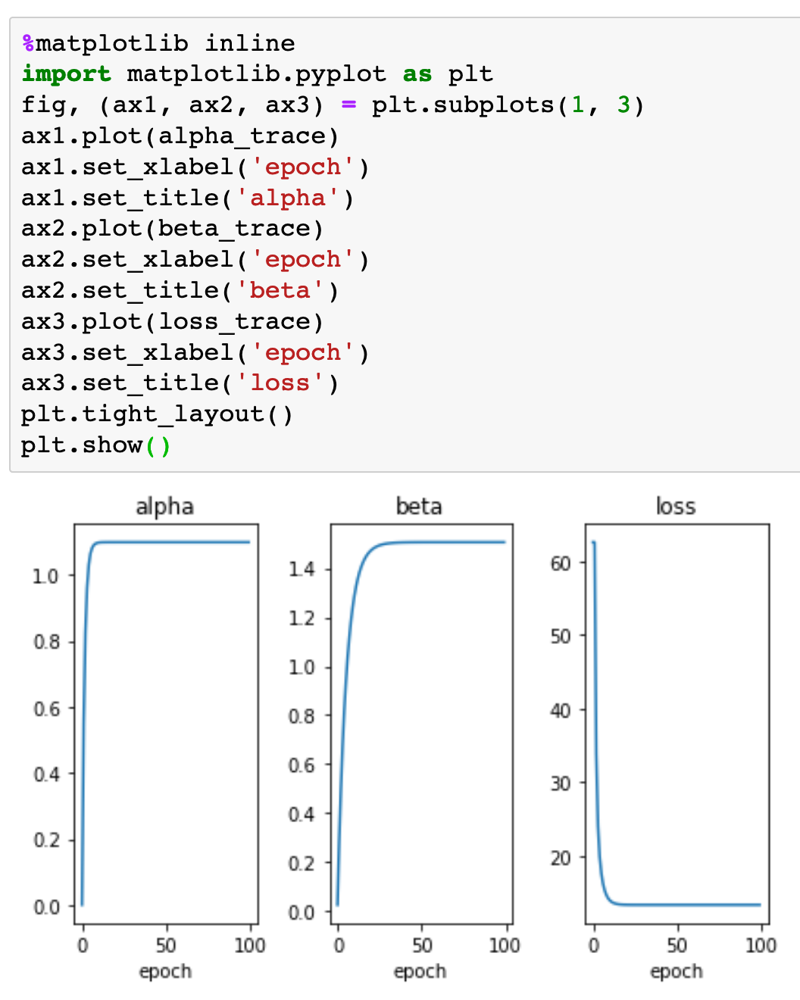
Now
Previously

Slide 15
Now
Previously

Slide 16
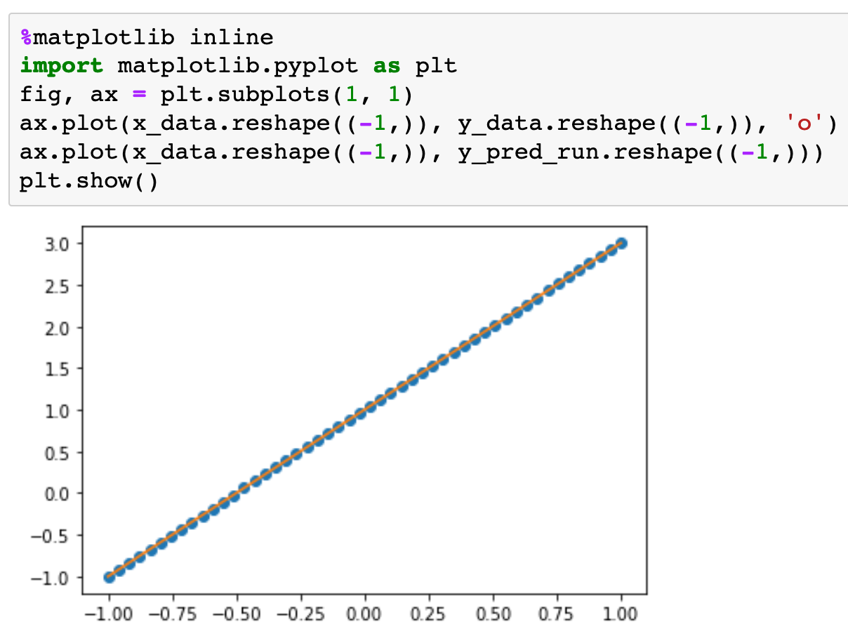
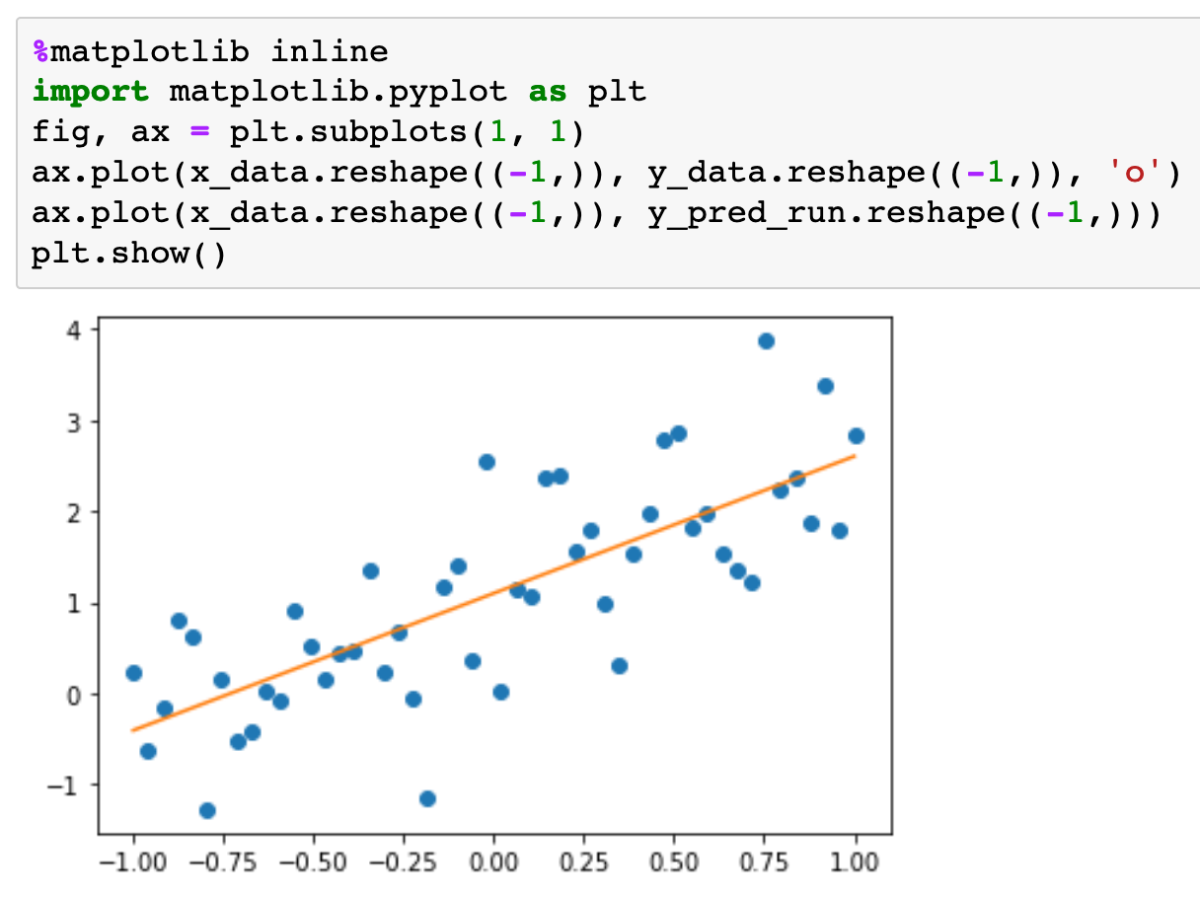
Previously

Slide 17
Now
Previously

Slide 18
Exercise
Write and run a code to find the slope and intercept of the learned straight line. Do you recover the original slope 2 and intercept 1? Why or why not?

Slide 19
Now
Let’s Play with Code

